Slide 1

Business Model Canvas exercise – part two
This work is licensed under the Creative Commons Attribution 2.5 UK: Scotland License.
Notes:
Now that we’ve set the scene for today. We’ll get started on thinking about scoping and refining user requirements.
Without a solid understanding of what users want, it is impossible to develop services that will be used and valued. For the next 20 minutes, we’ll share some tips on how to start assessing user requirements at your institution. We’ve distilled key points from our How to Develop RDM
Services and How to Discover Requirements for Research Data Management Services guides – both are included in your packs so that you can delve into these in more detail once you return home.

Slide 2
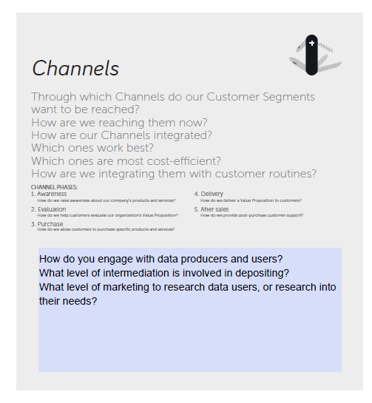
Exercise: Identifying service channels
Reconvene in your groups and chose two or three of your key activities, discuss for each:
Which channels work best to deliver value to your customers
Which channels do your customers use to connect with you as service providers
Which channels does the service use to promote awareness

